Slide 1
Hotel Aggregator Analysis Using Power BI
Mentorness Internship Program
Name: Shahid Ali
Batch: MIP-DA-07

Slide 2
1. Project Overview
This internship project aims to analyze a dataset of hotel aggregator listings using Power BI. The dataset comprises various attributes related to listings, hosts, reviews, and availability. The objective is to create comprehensive visualizations and insights that shed light on trends, patterns, and factors influencing the performance of listings. Through Power BI, I explored key metrics such as pricing, availability, host characteristics, and review scores to derive actionable insights for improving the overall quality and competitiveness of the listings.

Slide 3
2. Dataset Description:
id: Unique identifier for each listing.
listing_url: URL of the listing on the hotel aggregator platform.
scrape_id: Identifier for the data scraping event.
last_scraped: Date of the last data scrape.
source: Source of the listing information.
name: Name of the listing.
description: Description of the listing.
neighborhood_overview: Overview of the neighborhood where the listing is located.
picture_url: URL of the listing's picture.
host_id: Unique identifier for the host.
... (and many more columns capturing details about hosts, location, property type, room details, amenities, pricing, availability, reviews, and other relevant information)

Slide 4
3. Project Objectives
Geographical Insights
Pricing and Availability Analysis
Host Performance
Review Scores and Guest Satisfaction
Property Type and Room Analysis

Slide 5
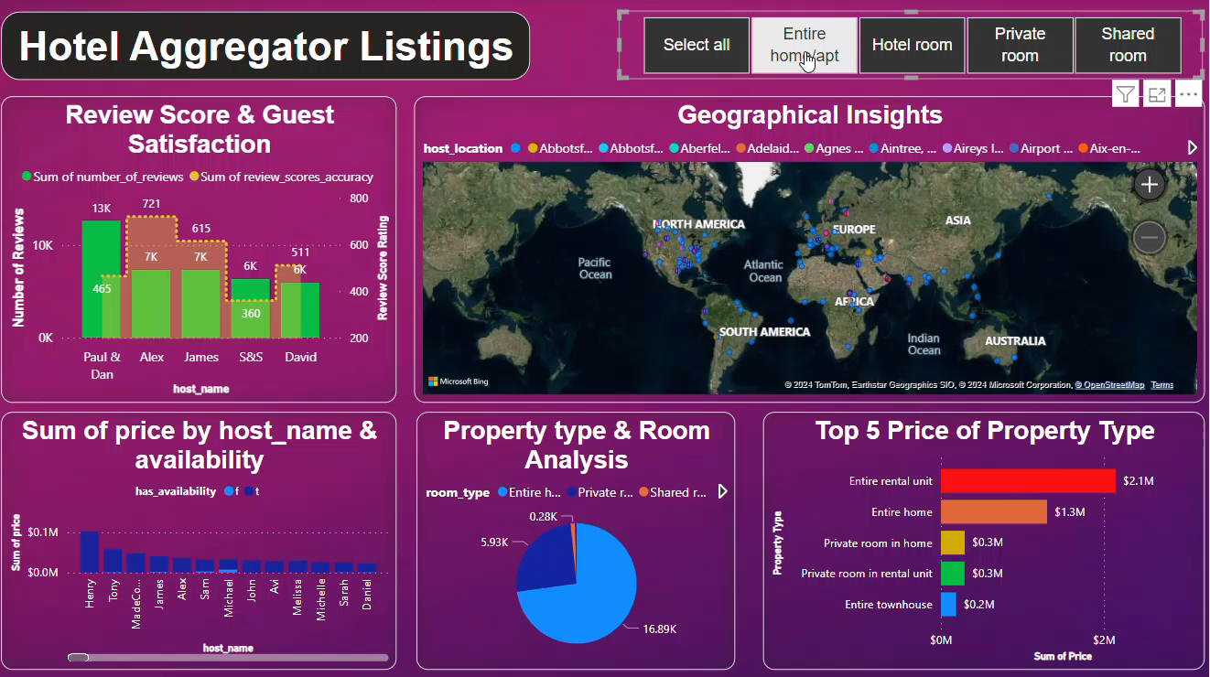

Slide 6
4. Conclusions
Melbourne, Australia boasts the highest number of listings. Guest satisfaction is influenced by several factors, including cleanliness, amenities, communication, and the overall experience. There exists a strong and evident proportional relationship between the total count of reviews and the total number of listings. This correlation provides hosts with more opportunities for ratings, thereby increasing their popularity. The capacity of accommodation does not necessarily correlate proportionally with the price. Entire room types are typically the most affordable option available.

Slide 7
Thank You
Reflecting on our past brings clarity, finding peace in the present brings tranquility, and envisioning our future brings purpose.

